Slide 1


Introducing the PreGISP® Program
A Smart Start For Emerging GIS Professionals

Slide 2


ABOUT
GIS CERTIFICATION
INSTITUTE
GISCI provides the Geospatial Community with the only professional GIS certifications: the GISP® and GISP-E.

Slide 3

About GISCI
The GIS Certification Institute (GISCI) is a U.S.-based nonprofit 501(c)(6) organization established in 2002 to support and advance excellence in the geospatial profession.
GISCI has two internationally recognized certification programs—GISP® (Certified GIS Professional) and GISP-E® (Emerging GIS Professional)
GISCI is committed to promoting ethical practices, fostering professional development, and building a strong, connected GIS community.

Slide 4
ABOUT THE
PreGISP®
PROGRAM
The PreGISP® program is a pathway to help recent graduates develop the qualifications required for GISP® certification as they begin their careers in the geospatial field.

Slide 5
What is the PreGISP® Program?
Offers an accelerated pathway to becoming a GISP®
Offered as a certification that is exam-only based
Based on a standardized pre-professional exam based on UCGIS Geospatial Body of Knowledge
Offered at the end of a student's career in their final GIS&T class
Allows student to add the GISP-Emerging (GISP-E) credential to CV

Slide 6
What is the GISP-E Credential?
Students who successfully pass the exam will be awarded the GISP-Emerging credential and may use the GISP-E postnominal after their name.
The credential will be valid for 3 years from date of award and cannot be renewed.
The GISP-E exam is online proctored and offered during a limited window every April & November.

Slide 7
Who is a GISP-E candidate?
Undergraduate and graduate GIS students (2 or 4 year universities) preparing for the job market
  Must be within your final semester of education, or within six months of graduation to take the exam
Career changers entering the geospatial field
Early career professionals planning for long-term growth

Slide 8
Benefits of GISP-E Credential
Demonstrating knowledge: the GISP-E credential shows commitment to your career and validates your skills and knowledge.
Enhancing credibility: Credentials can boost your confidence and earn you respect from your peers and clients.
Career advancement: Credentials can help you meet workplace requirements, get a promotion, or change careers.
Valuing education and training: Credentialing programs can validate the education and training that students receive and can motivate them to continue to achieve.
Early Start: GISP-E holders can become a GISP® in three years instead of the typical four.

Slide 9
Why Become a GISP-E?
The PreGISP® Certification isn’t just a practice test—it’s a career development milestone. For students and new professionals, it bridges the gap between academic learning and professional certification.
It helps you think like a GISP® before you officially become one.

Slide 10
THE
PreGISP®
EXAM
Exam Creation, Content, and Study Resources

Slide 11
About the Exam
Derived from the combined the knowledge bases of the UCGIS GIS&T Body of Knowledge and the European EO4GEO Body of Knowledge
  521 knowledge, skills, and abilities (KSAs) identified.
The exam is designed to assess the knowledge you’ve gained during your education, covering 13 of these knowledge areas
The exam is proctored online, and costs $125 per attempt.

Slide 12
PreGISP Exam Blueprint
Concepts | Knowledge Area | Weight
AM15 | Analytical Methods | 18%
CV07 | Cartography & Visualization | 10%
CF09 | Conceptual Foundations | 14%
DM05 | Data Modeling | 12%
DS07 | Design of Systems | 6%
GC04 | GeoComputation | 3%
GD04 | Geospatial Data | 10%
GS07 | GI & Society | 3%
IP06 | Image Processing | 3%
OI05 | Organizational Inst. Aspects | 7%
PP02 | Physical Principles | 1%
PS07 | Platforms, Sensors | 9%
WB06 | Web-Based GI | 6%

Slide 13
Testing Dates
Next Testing Date: November 16-23, 2026
Deadline to Apply: November 2, 2026
Location: Worldwide; proctored online by Pearson VUE
1.) Submit your exam application online at the GISCI website.
2.) Pay the application and exam fees.
3.) After your payment is confirmed, Pearson VUE will send you an email with authorization to schedule your exam. Schedule your specific exam date.
​For more information, visit: https://www.gisci.org/PreGISP

Slide 14
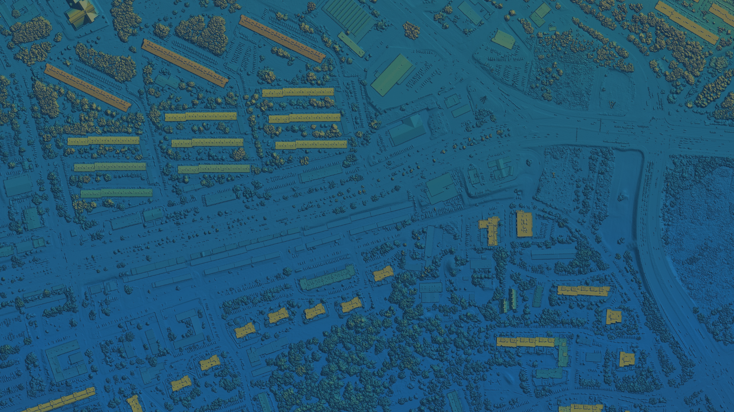
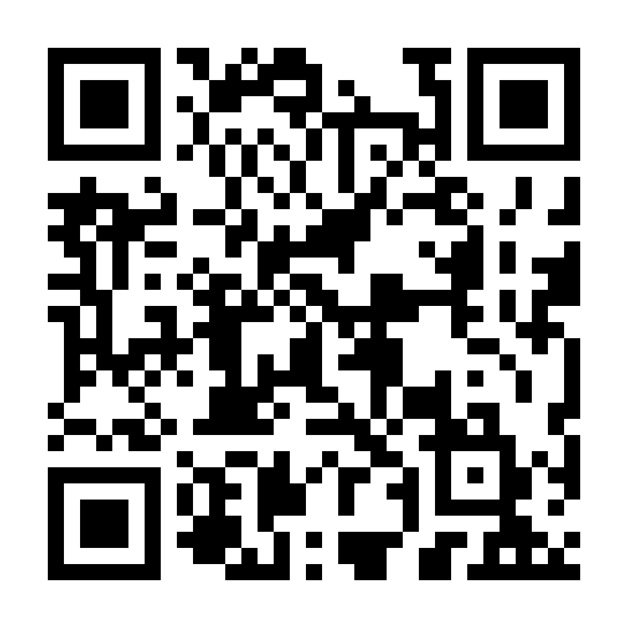
THANK YOU!
Questions? Contact Tony at tspicci@gisci.org

